Slide 1
Standards and market practice (including XBRL) – how far have we got and what’s next?
CorpActions 2011
Glazier’s Hall - London
Max Mansur
5 July 2011

Slide 2

Agenda
XBRL Taxonomy for Corporate Actions has been released – what is the potential for EU markets?
How is XBRL being implemented for Depositary Receipts – status of the Pilot?
What is XBRL’s relationship with ISO 20022? With ISO 15022?
How is SMPG market practice injected into XBRL?
How does an XBRL tagging tool support the issuer?
How can the result be consumed by the industry? How does this help the investment side?

Slide 3







Distance between Issuer and Investor
LAWYERS, ADVISORS, LEAD MANAGERS, REGISTRARS, TRANSFER/FILING/INFORMATION/PUBLICATION AGENTS
REGULATORS, SHARE REGISTER, ANALYTICS COMPANY
INVESTOR
ISSUER
EXCHANGE,
WIRE SERVICES,
REFERENCE & TRADING DATA SERVICES
FUND MANAGERS, FUND ADVISORS, INVESTMENT MANAGEMENT INSTITUTION, OFFSHORE INVESTORS
CENTRAL DEPOSITORY, CUSTODIANS, SUB-CUSTODIANS, GLOBAL CUSTODIANS, BROKER-DEALERS

Slide 4









Corporate Actions – problems and source
Upstream
Issuer/ agent
NO STANDARDS
NO COMMON IDENTIFIER
ELECTRONIC versus PAPER
Exchange
Regulator
SCRUBBING
SCRUBBING
Depository
SCRUBBING
Data
provider X
Data
Vendor Y
Downstream
MANUAL ENTRY
= DELAYS & RISK
> REDUNDANT
SCRUBBING
> REKEYING
OF DATA
Custodian A
Custodian B
Custodian C
MULTIPLE
INTERPRETATIONS
SCRUBBING (YET AGAIN)
REPEAT PROCESS FOR EACH CHANGE
IM/AM
NO SINGLE SOURCE
4
Any tolerances to consider?

Slide 5
High: ISO financial stds
Corporate Actions Landscape - standardization
Mixed: ISO, portal, proprietary
Proprietary, ISO potential
None - XBRL potential
Issuer
Shareholders’
Meeting
Unlikely – Retail services
Courts
Transfer Agent
Registrar
Publication / Info Agent
Tabulator / Agent
Exchange
Regulator
cross-border
Data
Providers
CSD
Tax
Authority
Proxy
Agent
B/Ds
Global
Custodians
Investment
& Funds Mgrs
Sub-
Custodians
Institutional Investor
Retail Investor

Slide 6
High
Sub-custodians in Asset Servicing Landscape
Low
Little
XBRL potential
Issuer
Shareholders’
Meeting
Unlikely
Courts
Transfer Agent
Registrar
Publication / Info Agent
Tabulator / Agent
Exchange
Regulator
Tax
Authority
Data
Providers
CSD
Proxy
Agent
B/Ds
Sub-Custodians
Global Custodians
Investment
& Funds Mgrs
cross-border
Institutional Investor
Retail Investor
XBRL for Corporate Actions – 24 May 2011 – Confidentiality: Public

Slide 7
What is XBRL
eXtensible Business Reporting Language
XML based
A technology to code & bring meaning to documents
Allows to tag data with specific definitions
  meta-data
  « information about information »
tags are unique for each concept & organized in a taxonomy
  data dictionary
  eg US GAAP, IFRS, ISO 20022 corporate actions, …
Non-proprietary, open source standard
XBRL for Corporate Actions – 24 May 2011 – Confidentiality: Public

Slide 8
The XBRL approach (all domains)
BUSINESS STANDARDS
XBRL Standard
Business Facts
XBRL TAXONOMY
(data dictionary, metadata)
Business
Reports
XBRL Instance
=
Examples:
IFRS, US GAAP, JP GAAP
UK HMRS, FDIC
INTERPRETATION
Features: machine readable, structured, comparable, analyzable, consistent, verifiable, usable data
XBRL for Corporate Actions – 24 May 2011 – Confidentiality: Public

Slide 9
XBRL – Where Used? Corporate Actions opportunity?
UK: HM Revenue & Customs, Companies House
EU: Basel II Compliance, EBA for FINREP/COREP
XBRL reporting in Belgium, Ireland, France, Spain, Italy, Poland , Denmark, Germany, France, Portugal, etc.
US GAAP SEC mandated; FDIC; Proxy; Mutual Funds
Issuer to Investor: Corporate Actions DTCC, SWIFT, XBRL US
Corporate Actions: Shanghai & Shenzhen Stock Exchanges,
XBRL in use for gov’t
or financial reporting
XBRL CA leading
or committed
XBRL CA emerging
interest
Ongoing global revolution in financial reporting standardization with systemic disambiguation and transparency…
…disguised as XBRL adoption
Active in CA Market
Practice & Standards
Potentially considering
XBRL for Corporate Actions – 24 May 2011 – Confidentiality: Public
Notes:
[see next page for comments about XBRL CA specifics for certain countries]
XBRL usage status
US: Mandated for all exchange listed companies to report quarterly/annual financials (SEC); mandated banks to report deposits (FDIC); other usage Funds Reporting (voluntary)
China: General Purpose Taxonomy mandated for reporting in multiple government agencies, mandatory for regulatory commission; voluntary SSE
India: being mandated for company reporting (by SEBI) and additional agencies are adopting
South Africa: used by JSE and by its listed companies on voluntary basis, plus other government and company voluntary usage
Japan: used by TSE, FSA, BOJ, and national tax agency for mandatory filing
EU: Corep and Finrep reporting are going to be mandated
UK: HM Revenue & Customs, Companies House – Mandatory filing
Australia: Prudential Regulatory Authority – Mandatory
Belgium: Mandatory Bank of Belgium, CBFA, COREP
Netherlands: Voluntary, but may become mandatory; being used to reduce administrative burden through overall government program
France: Mandatory bank and corporate reporting for various agencies
Germany: Mandatory bank and corporate reporting for various agencies
Spain: Mandatory bank and economic reporting
Poland: Mandatory bank
Sweden: Voluntary bank and finance
Denmark: Voluntary finance and commerce
Italy: Mandatory national bank, Voluntary commerce
Singapore: Mandatory ACRA (small companies – for tax as well), voluntary corporate filings
Korea: Voluntary financial supervisory service
Israel: Mandatory corporate e-filing
Ireland: Mandatory Financial Service
Canada: Voluntary Securities Administrators
Estonia, Switzerland, Slovakia, Czech Republic, Mexico, Brazil and many other countries are developing XBRL or planning to implement

Slide 10
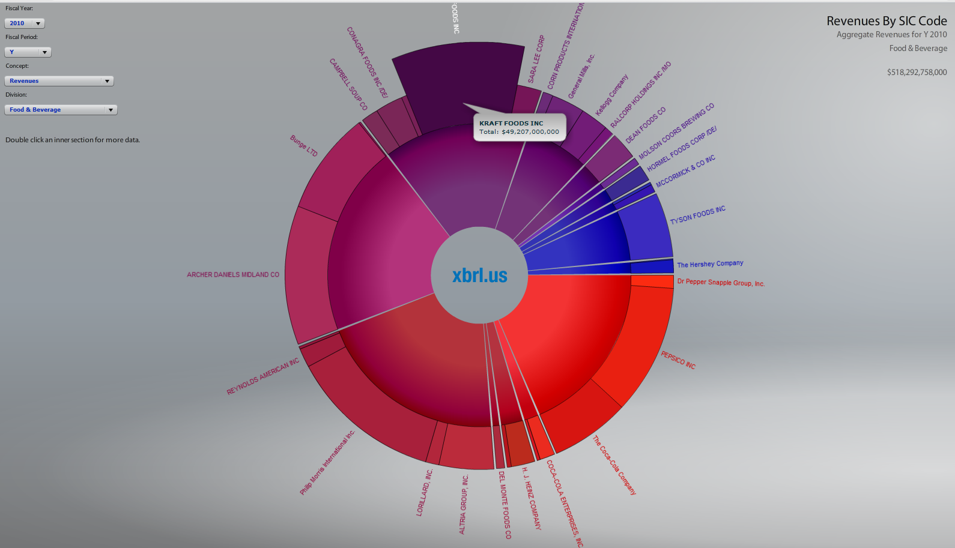
Companies Incorporating XBRL (XBRL US)

Slide 11
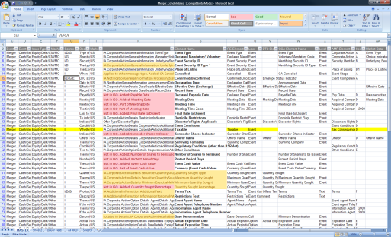
Corporate Actions Taxonomy Structure
XBRL Corporate Actions Dictionary
XBRL Corporate Action Taxonomy
Modeling
Business Concepts
SWIFT 20022 Data Dictionary
Industry Accepted Event Templates

Slide 12
SMPG’s EIG to drive the template
Corporate Action Event |  |  |  |  |  | GLOBAL GRID
Short Description | Definition / comments | CAEV | CAMV | 1 or 2 event | with(out) intermediate securities | CAMV | CAOP | Date | Period | Rate | Price | Definition / comments
Cash Dividend | Definition "Distribution of cash to shareholders, in proportion to their equity holding. Ordinary dividends are recurring and regular. Shareholder must take cash and may be offered a choice of currency" | DVCA | MAND |  |  | MAND | CASH | XDTE [M] EARL [O] VALU [O] PAYD [M] RDTE [M] |  | GRSS [M] NETT [O]
 | Where a currency choice is offered |  | CHOS |  |  | CHOS | CASH | XDTE [M] EARL [O] VALU [O] MKDT [O] RDDT [O] PAYD [M] RDTE [M] |  | GRSS [M] NETT [O] EXCH [O]

Slide 13








Target Flow for XBRL CA for American Depositary Receipts (ADR)
Market of Issuer
FINRA
Local Issuer
Ex-date?
Registrar / Transfer Agent
ADR Depositary
Stock Exchange
NYSE/NASDAQ
Central Securities Depository
Local Custodian
Exchange
Website
=
PDF
Announcement
SEC
ADR
Website
=
GlobeTax
EDGAR
Website
Tax
Treatment
Other Recipients
=
CSD (DTCC)
Manual
Input
MX
=
DTCC ISO
20022 msg
DTCC
Website
Tax
Treatment
MX
=
XBRL Data
Instance
Custodian
ADR Investor
XBRL for Corporate Actions – 24 May 2011 – Confidentiality: Public

Slide 14
ISO 20022 Corporate Actions Messages
 | MX Identifier | Proposed ISO 20022 Messages Names | Abbreviated Name | Equivalent ISO 15022 Messages
1 | seev.031.002.01 | Corporate Action Notification | CANO | MT564
2 | seev.033.002.01 | Corporate Action Instruction | CAIN | MT565
3 | seev.036.002.01 | Corporate Action Movement Confirmation | CACO | MT566
4 | seev.037.002.01 | Corporate Action Movement Reversal Advice | CARE | MT566
5 | seev.039.002.01 | Corporate Action Cancellation Advice | CACN | MT564
6 | seev.040.002.01 | Corporate Action Instruction Cancellation Request | CAIC | MT565
7 | seev.032.002.01 | Corporate Action Event Processing Status Advice | CAPS | MT567
8 | seev.034.002.01 | Corporate Action Instruction Status Advice | CAIS | MT567
9 | seev.041.002.01 | Corporate Action Instruction Cancellation Request Status Advice | CACS | MT567
10 | seev.035.002.01 | Corporate Action Movement Preliminary Advice | CAPA | MT564
11 | seev.038.002.01 | Corporate Action Narrative | CANA | MT568
12 | seev.042.002.01 | Corporate Action Instruction Statement Report | CAST
13 | seev.044.002.01 | Corporate Action Movement Preliminary Advice Cancellation Advice | CAPC | MT564
XBRL for Corporate Actions – 24 May 2011 – Confidentiality: Public

Slide 15
DTCC ISO 20022 adoption experience
Mapping to ISO 20022
Some proprietary elements not used
Legacy system
ISO 20022 CA messages
Proprietary
Format files
ISO 20022 elements not mapped
ISO 20022 elements
Mapped to proprietary
Participants
Important Steps
working with SWIFT to avoid missteps on standards, design
working with clients to ensure validity of design, extensions, etc.
piloting with early adopters and verifying feasible timelines
ISO 20022 CA Extensions
Extensions to be changes proposed for ISO 20022 future consideration
Extensions temporary - to be discarded after proprietary system is adapted
Elements to keep local for market needs
- final disposition yet to be determined

Slide 16
Proxy Voting - MT to MX
Replacing ISO 15022 functionality for “meeting” events
Function of Message | MT ISO 15022 | MX ISO 20022
Meeting Announcement or Modification | MT564 with event type CAEV = MEET, CMET, XMET, or OMET (or MT568/599) | MeetingNotification seev.001.001.03
Cancellation of Meeting or Meeting Notification | MT564 | MeetingCancellation seev.002.001.03
Confirmation of Entitlement | MT564 | MeetingEntitlementNotification seev.003.001.03
Voting Instruction (incl voting registration, meeting attendance, appointing proxy,…) | MT565 | MeetingInstruction seev.004.001.03
Cancellation of Voting Instruction | MT565 | MeetingInstructionCancellationRequest seev.005.001.03
Status on Voting Instruction | MT567 | MeetingInstructionStatus seev.006.001.03
Confirmation of Vote Execution | n/a (nominal use of MT568/599) | MeetingVoteExecutionConfirmation seev.007.001.03
Results of Meeting | n/a (nominal use of MT568/599) | MeetingResultDissemination seev.008.001.03
New
New
XBRL for Corporate Actions – 24 May 2011 – Confidentiality: Public
Notes:
This is the full list of messages that are available . …(Message types)
We know that limited automation was achieved with the ISO 15022 standard CA messages <<MT 56X>> for proxy voting; primarily between the sub-custodians and the proxy agents. Unfortunately, these message formats are not sufficient for all workflows and processes required for proxy voting.
For example, Handling the meeting agenda and the resolutions and such with ISO 15022 has always been troublesome and many resort to text messages such as MT 599 or MT 568, or fax, or email.
So, there is so much better functionality and capability with ISO 20022 messages; they fill in the gaps and help to transmit relevant, comprehensive and complete information to investors.
Additionally, adding the process of confirmation of vote execution and results of the meeting can only enhance investor/shareholder relations with custody as well as with the corporate issuer.

Slide 17
DTCC’s timeline to roll out ISO 20022
Overall Roadmap
Implementation Date
Phase I
DTC Data into
WAVES
Additional DTC specific data elements (276 out of 329 fields used for payments processing) passed through to WAVES platform for GCA VS customers.
Oct ‘09
ü
Phase IIa
Announcements ISO 20022
New ISO 20022 announcement messages, pilot testing begins, new customer user interface for announcements available for testing. implementation targeted for Q4 2011.
Apr ‘11
Phase IIb
Full XBRL Interface
XBRL interface available, DTCC to receive tagged data for corporate action announcements.
Q4 11
Phase III
Distribution Events Announcements and Processing
New customer user interface and ISO 20022 messaging is introduced for the entire lifecycle for distribution events, from announcements through elections and payments. Existing distribution processing systems are updated to carry the new unique ID.
2012
Phase IV
Redemption Events Announcements and Processing
Same steps as in Phase III, but applied to Redemption events.
2012
Phase V
Reorg Events Announcements and Processing
Same steps as in Phase III, but applied to Reorg events, and Reorg processors are upgraded. DTC legacy CCF files are modified to handle new activity types and data elements.
2013
Phase VI
Retire DTC Legacy Files
All DTC legacy CCF files (DIVANN, REDEM, REORG, MUNANN, RDPRPT, CMORTS) , the GCA proprietary file and ISO 15022 will be retired.
2015 or sooner
XBRL for Corporate Actions – 24 May 2011 – Confidentiality: Public

Slide 18
WHAT SHOULD BE THE PRIORITY?
Data from Issuers
  How? Regulatory/Rules or Industry? Business barriers?
  XBRL? ISO 20022? Who: exchanges, registrars, wire services, data vendors?
  Endorsement – “nice idea” or potential reality? CAJWG, ISSA, US Issuers to Investors, etc.
  Skin in the game? Dichotomies? Disincentives?
Standards
  Incentive to move to ISO 20022? How long coexistence?
  How long will legacy, proprietary & non-XML standards survive?
  In dynamic world can we wait 21 months for change releases?
Market Practice
  Evaluate-able (STaQS), but not widespread. Is it complete and accurate? Why isn’t every market committed?
  Should it be built-in? Certification for data providers?

Slide 19
Useful Links
Issuer to Investor: Corporate Actions –
market initiative of DTCC, SWIFT, and XBRL US
Website http://xbrl.us/i2i
Download the business case at http://xbrl.us/i2ibusinesscase
Download the CA taxonomy at http://xbrl.us/publicreviews/Pages/2010corpactions.aspx
DTCC website Transforming Corporate Actions http://www.dtcc.com/leadership/issues/xbrl/index.php
International Securities Services Association (ISSA)
Global Corporate Actions Principles and Issuer Outreach:
  http://www.issanet.org/pdf/2010_ISSA_CA_WG_REPORT.pdf
  http://www.issanet.org/pdf/ISSA_Issuer_Outreach_Final_20_Jan_2011.pdf
SWIFT - Corporate Actions and XBRL information
  http://www.swift.com/products/corporate_actions/additional_information

Slide 20
Thank you

